Slide 1
NE 763: Advanced Reactor Materials
Fall 2026
Dr. Benjamin Beeler

Slide 2
Last Time
Exam. Graded exams back at the earliest on Tuesday (last distance exam on Monday)
Before that: started on SFRs
Two fuel types:
  MOX and metallic
Two reactor designs
  pool type and loop type
Increased safety
  high margin to boiling
  inherent negative reactivity feedback coefficient
  higher thermal conductivity -> higher overpower to melt
High swelling of alpha U: alpha tearing/cavitation swelling low T; higher T GB porosity

Slide 3
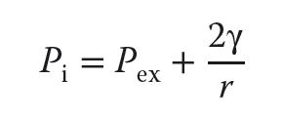
Swelling in Gamma U
Gamma U is BCC
Swelling in the higher temperature phases occurs primarily by growth of fission gas bubbles, and is isotropic
All phases will also have solid fission product swelling
Fission gas is effectively insoluble in metallic U, and thus prefers to precipitate
Sufficiently large bubbles can maintain an equilibrium gas pressure by balancing the surface tension and the external pressure
This growth is described by the Young-Laplace equation
The external pressure is determined by the plastic flow characteristics of the fuel surrounding the bubble and the mechanical restraint of the cladding
Fission gas swelling can be substantial, and must be accounted for

Slide 4
Alloying to modify properties
Small alloying additions were explored to limit the fission gas swelling behavior
Adjusted U – U alloyed with small amounts of Al, Fe, or Si
Additions form precipitates and act as point defect sinks, limiting swelling for low burnups
U-Fissium contained Mo-Ru, with lesser amounts of Rh, Pd, Zr, and Nb, and was the early EBR II fuel, typically 5 wt.%
Higher content alloys have focused on elements that form extensive solid solutions with U in the high-temperature γ-phase, specifically Mo, Zr, Ti, and Nb
These elements lower the temperature of the cubic γ-phase boundary, allowing more of the fuel to operate in the isotropic γ-phase; they also increase the solidus temperature, raising the margins at which the fuel melts
The addition of Zr and Mo seem to most substantially reduce the swelling of U

Slide 5
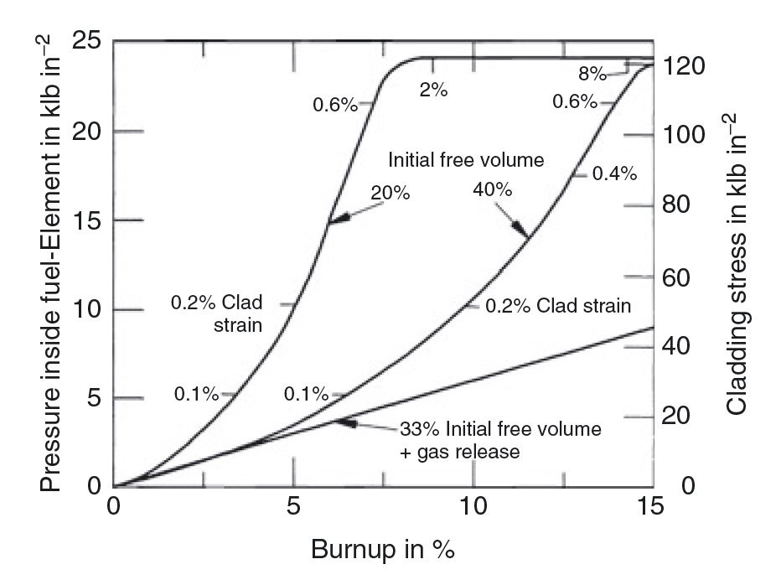
Accommodation of Swelling
With high-content alloys, calculations of fuel swelling and gas release showed that if 30-40% free volume was afforded inside the cladding, fuel could swell, and when it contacted the cladding, allow for mechanical strength of cladding to counteract further radial swelling
It was found that the majority of fission gas is released by about 30% swelling, and by including a large plenum, stresses on cladding could be reduced
**20% and 40% here don’t account for gas release from the fuel

Slide 6
I told you that to tell you this…
Provided context to get us to the point where we can actually talk about the reactor system

Slide 7
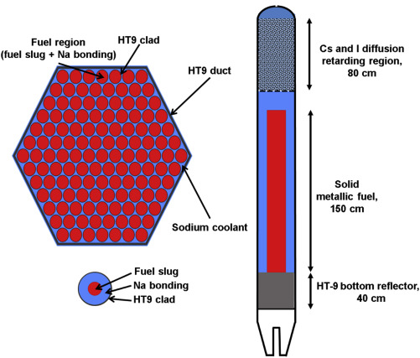
Reactor Geometries
Metal fuels are ideal for fast reactors because they have higher densities of fissile and fertile materials and provide higher breeding ratio
The burnup of metal fuel in the early days was limited to a few atom percent (at.%) because of the increase in the fuel–cladding mechanical interaction (FCMI) caused by gas swelling of fuel alloys
Reducing the fuel smear density to about 75% is effective in promoting fission gas release before fuel-cladding contact and in suppressing FCMI

Slide 8
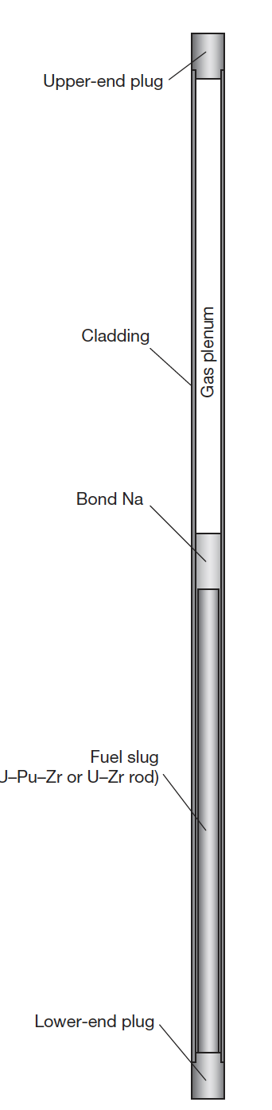
Base Metal Fuel System
The typical metallic fuel consists of a U(Pu)–10 wt% Zr fuel slug with ~75% smear density
The cylindrical fuel alloy rod is called a ‘fuel slug
The annular gap between the fuel slug and the cladding is filled with sodium (bond sodium)
A relatively large gas plenum (1-1.5x fuel length), which is a space above the fuel slug, is provided to mitigate the pressure of the fission gas accumulating during irradiation

Slide 9
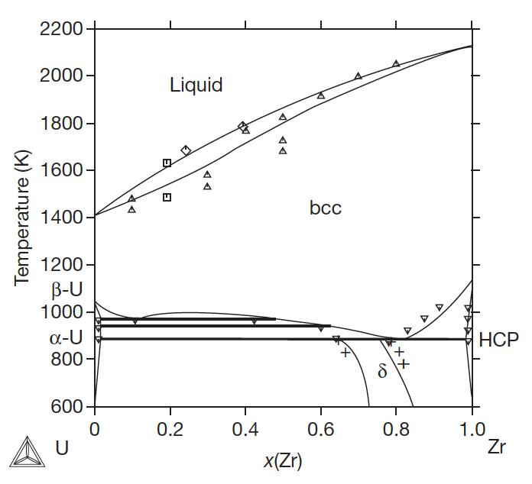
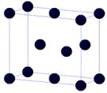
The U-Zr System
Metallic uranium is alloyed with Zr to stabilize the bcc phase, increase the melting point, improve mechanical properties, and reduce swelling
Typical composition is 10 wt.%, or approximately 22 atom %
At relevant temperature ranges in SFRs, multiple phases will be present (red line)

Slide 10
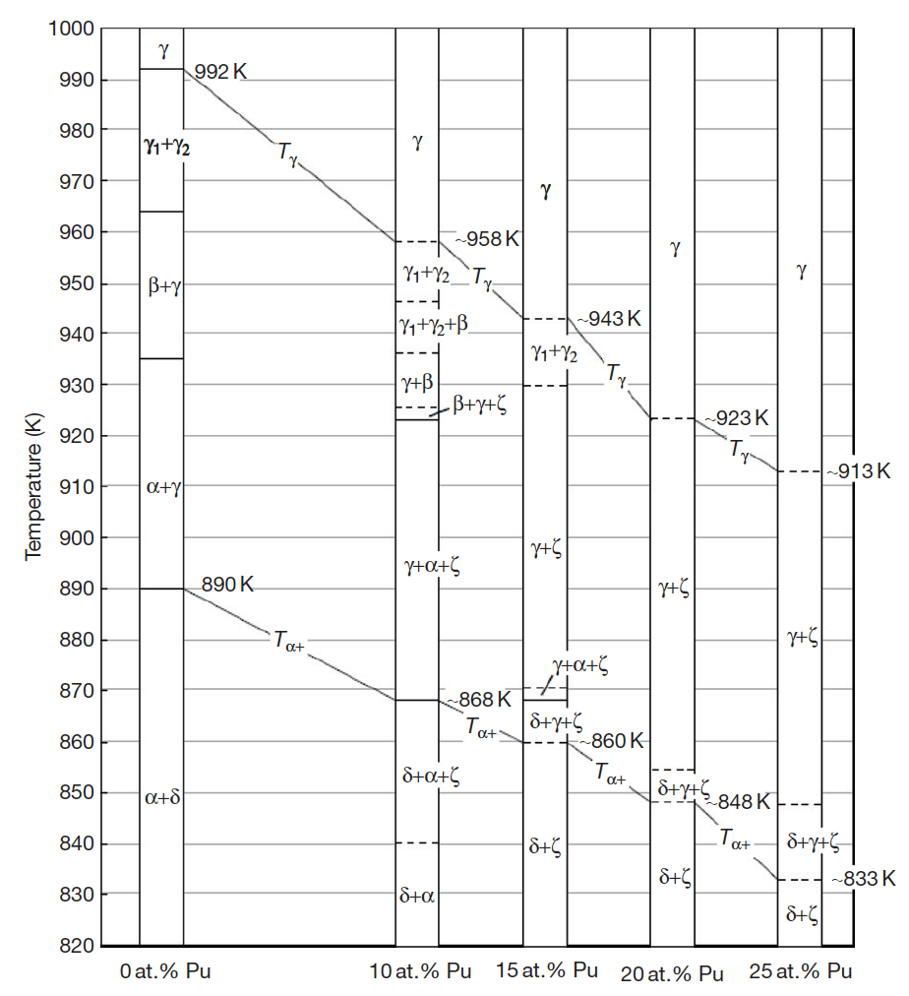
U-Pu-Zr
Ternary phase diagram isotherms
γ: Body-centered cubic (bcc), has complete solid solubility for bcc ε-plutonium and bcc β-zirconium
α: Orthorhombic allotropic modification of uranium that dissolves up to 15 at.% of plutonium, but has limited solubility for zirconium
β: Tetragonal allotropic modification of uranium that dissolves up to 20 at.% of plutonium, but has limited solubility for zirconium
η: A high-temperature intermediate phase in the U–Pu binary system that is believed to be tetragonal and has limited solubility for zirconium
ζ: A complex cubic U–Pu intermediate phase that dissolves up to 5 at.% zirconium
δ: A hexagonal intermediate phase in the U–Zr system that occurs approximately at the composition UZr2 and has extensive solid solubility for plutonium

Slide 11
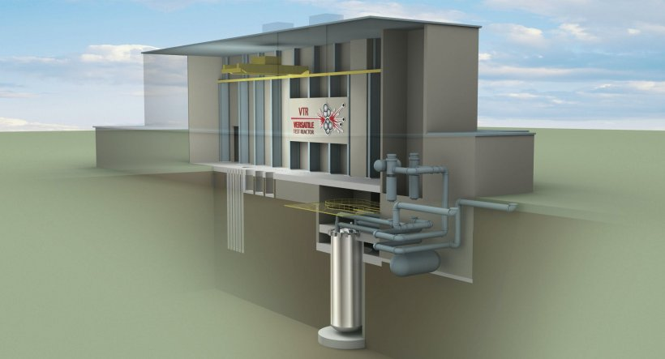
U-Pu-Zr
The U-Pu-Zr system was the fuel choice for the Integral Fast Reactor design of the 1980s, and the current/former Versatile Test Reactor design
U-Pu-Zr alloys are the most recent alloys under active exploration, and thus have the most recent experimental data
Note: TerraPower is using U-Zr fuel, presumably due to proliferation/regulatory reasons

Slide 12
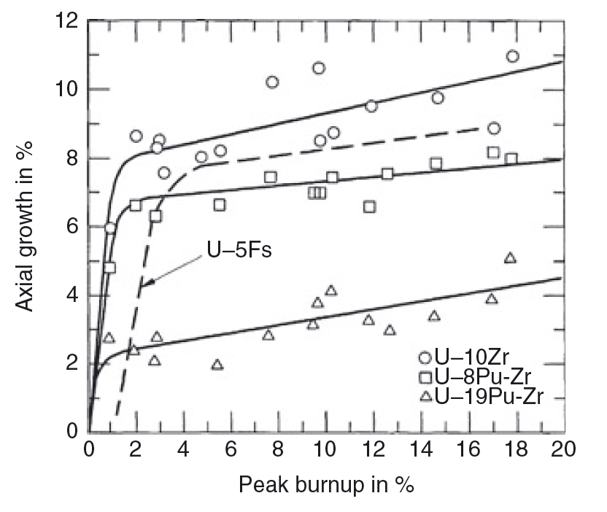
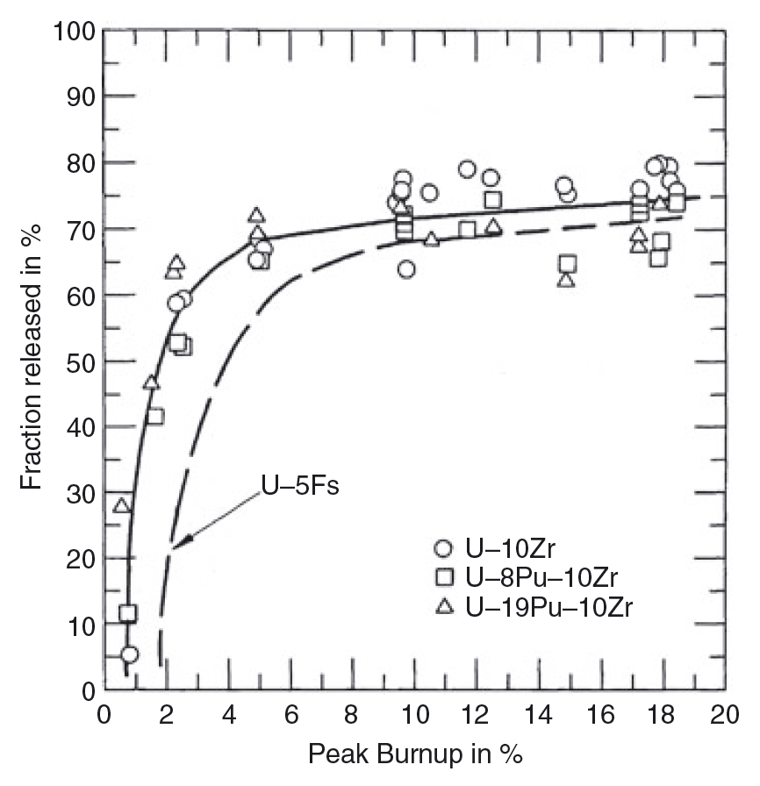
U-Pu-Zr Swelling
Swelling is typical of metallic fuels, in that it occurs rapidly, leveling off once in contact with the cladding
All U-Zr type allows irradiated in EBR-II showed very similar swelling behavior
Fission gas release occurs within the first 5% burnup, corresponding with the rapid swelling
These fuels swell less in the axial direction than in the radial direction, if isotropic swelling is assumed

Slide 13
U-Pu-Zr Swelling
The axial/radial variance is believed to be due to the difference in swelling behavior between the hotter center of the fuel pin and the colder periphery
The gamma phase dominates in the center of the fuel pin at high temperatures
This phase has large gas bubbles, indicative of a higher plasticity of the fuel and, therefore, a lower capability to sustain shear stresses
gamma

Slide 14
U-Pu-Zr Swelling
The alpha phase dominates on the colder periphery of the fuel pin, and has smaller, textured porosity (really alpha/delta mixed)
The alpha phase is known to have higher strength, and is assumed to be less plastic than gamma
The fission gas pressure in the center can potentially result in a near-biaxial loading of the peripheral shell, the radial stress component being twice the axial component
A stress effect on swelling in the peripheral fuel zone would result in a larger radial strain, and hence anisotropic swelling
alpha zone

Slide 15
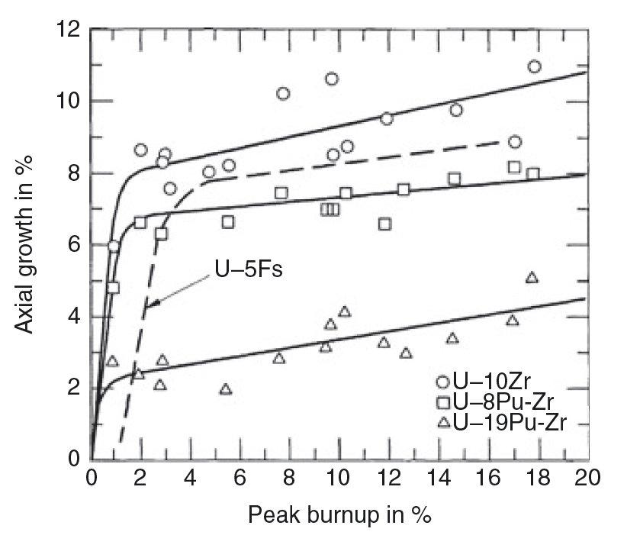
U-Pu-Zr
An increase in the Pu content exacerbates the anisotropic swelling
This is believed to be driven by the redistribution of Zr along the temperature gradient of the fuel
My suspicion is that there is also a substantial creep effect that leads to radial growth over time… but this is just my theory for now

Slide 16
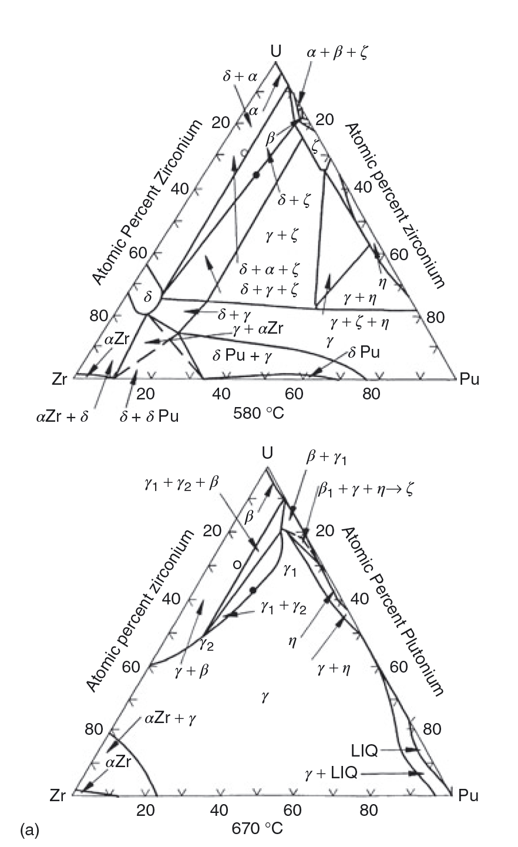
U-Pu-Zr Phases and Redistribution
Various phase boundaries exist radially across the fuel
The solubility of Zr in these phases varies with temperature; thus, a driving force for diffusion can be created both by the gradient in chemical potential, and by the temperature gradient

Slide 17
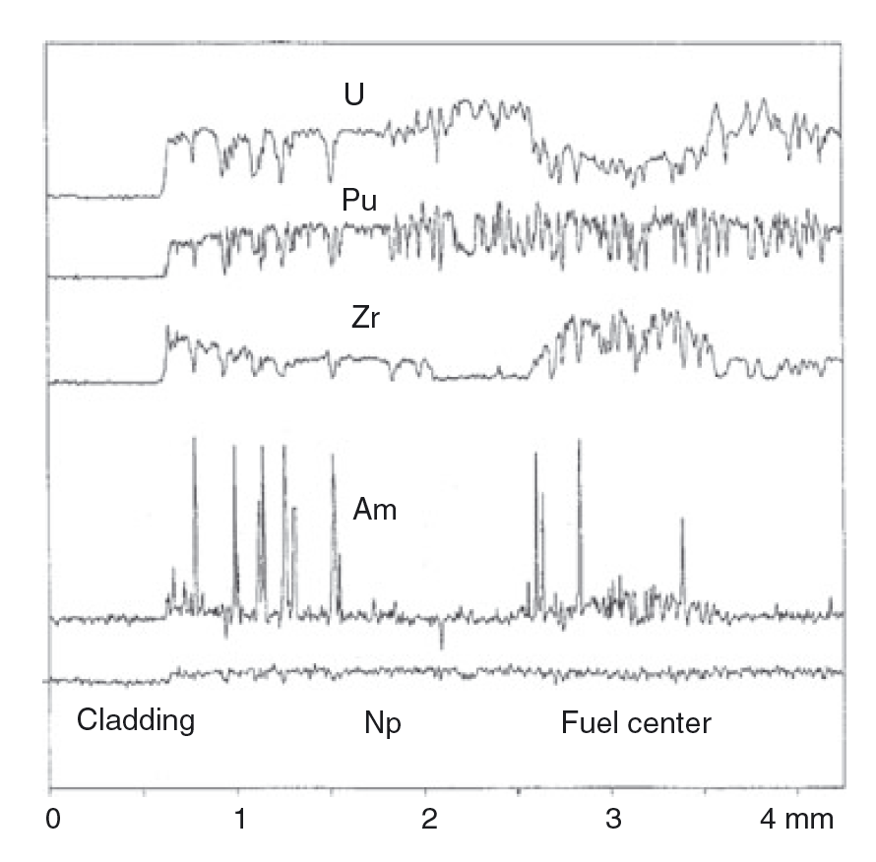
Redistribution
There can exist three compositional regions: 1) enriched Zr, 2) depleted Zr, 3) as-fabricated Zr
Zirconium diffuses up the temperature gradient to the high temperature gamma phase, leaving the intermediate temperature beta U phase
Uranium compensates by diffusing to the intermediate region
At lower T, decomposition into alpha/delta phases – with local low and high Zr content

Slide 18
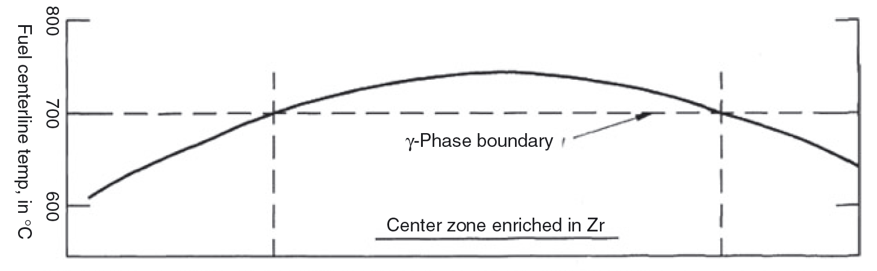
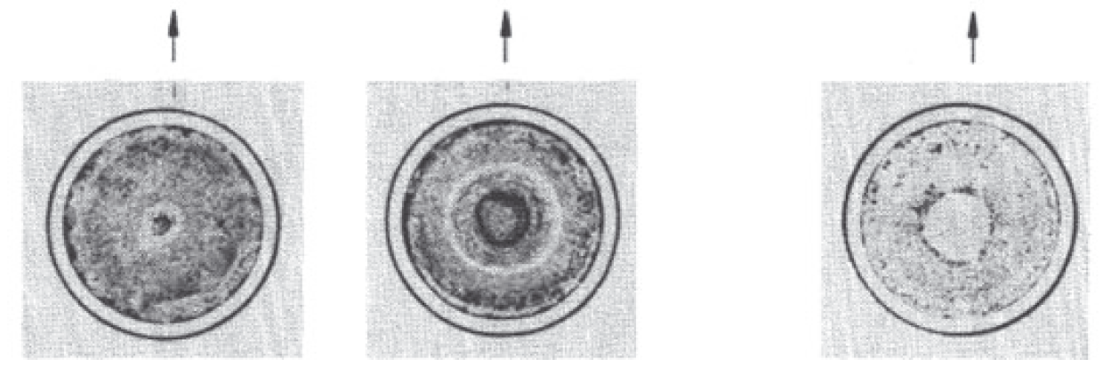
Redistribution
The location of the radial zones essentially follows isotherms in the fuel which are determined by the various phase boundaries of the alloy
The extent of redistribution, and the radial location of the individual compositional regions, varies axially with temperature
Both chemical potential and Soret effect diffusion contribute

Slide 19
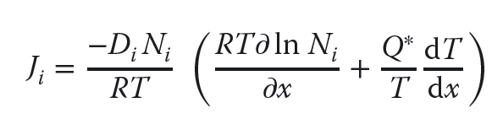
Soret Diffusion
Soret effect is a phenomenon observed in mixtures of mobile particles where the different particle types exhibit different responses to the force of a temperature gradient
The solute flux in a temperature gradient is characterized by the heat of transport, Q*, of the migrating solute according to Fick’s law:
where Di and Ni are the diffusivity and concentration of the migrating solute
The heat of transport can be either positive or negative, depending on the sign and magnitude of its components

Slide 20
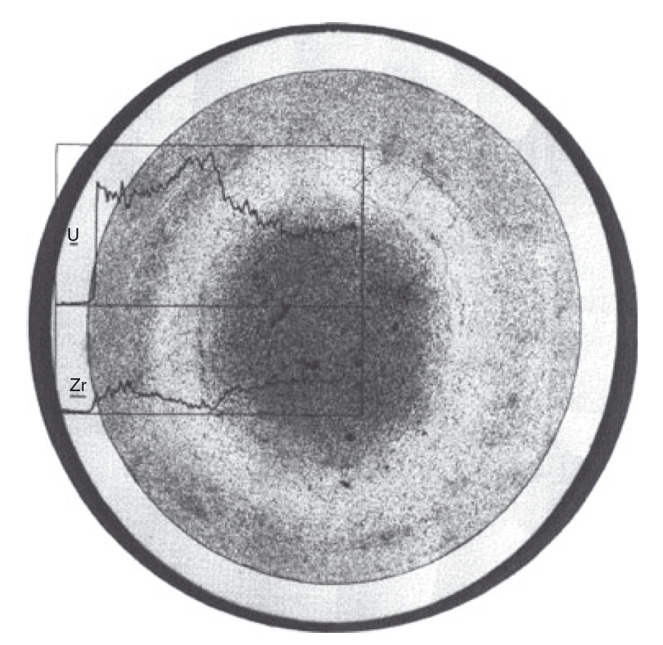
Soret Diffusion in UZr
The value of Q* for pure U was measured to be +5 kcal/mol and to be −34 kcal/mol for Zr
Thus, in their pure states, U moves down a temperature gradient while Zr moves up, but it is unknown if this behavior directly translated to U-Zr alloys
For low Pu content alloys, the rate of redistribution is similar to UZr

Slide 21
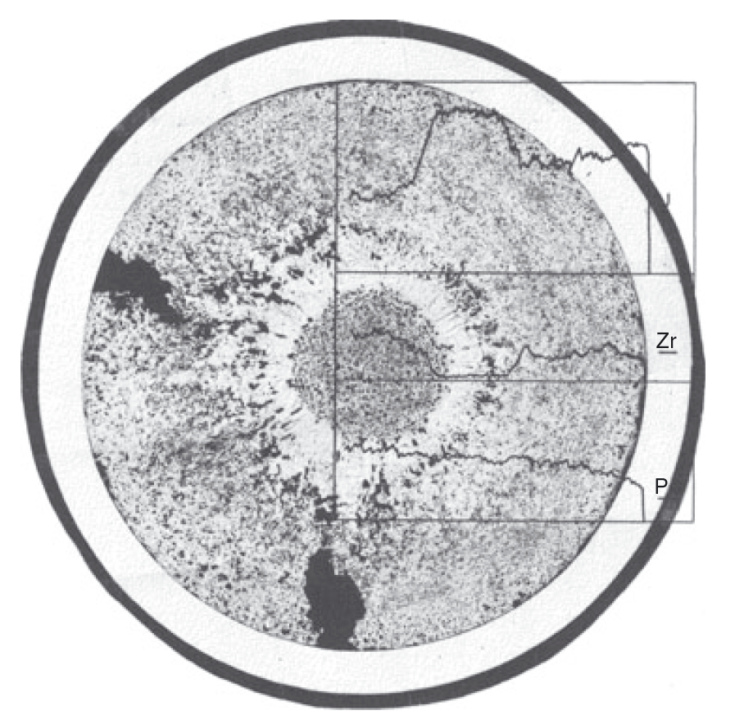
Soret Diffusion in UZr
For high Pu content alloys (>19%), redistribution is much more rapid
At the right is a 3% burnup fuel slug at a similar power density to the U-Zr slug in the previous slide
There is either a higher chemical driving force, or more rapid Zr diffusion present in these alloys
This more rapid redistribution can lead to greater anisotropic swelling, and thus more rapid radial swelling

Slide 22
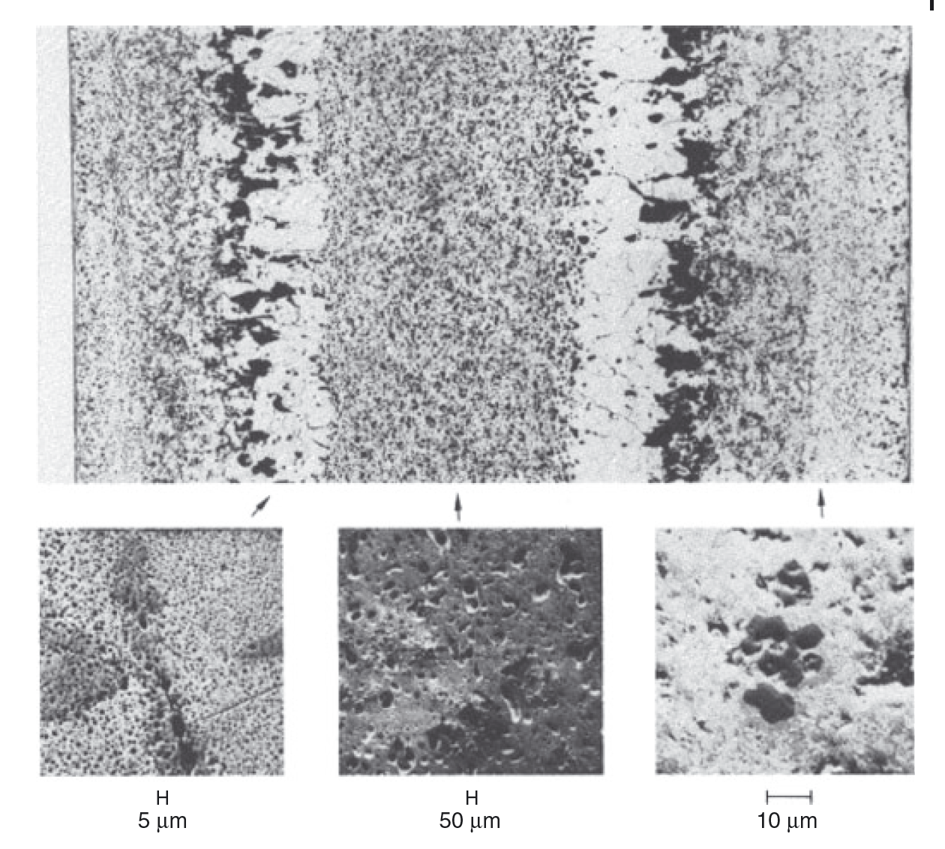
Variable Porosity
The porosity development depends on the phases present in the fuel
In all alloys, the high-temperature cubic U γ-phase exhibits the characteristic large interconnected bubbles similar to those observed in pure γ uranium
Different bubble sizes, densities, and morphologies can exist depending upon the local phase

Slide 23
Variable Porosity
In U-Zr alloys, low-temperature U alpha phase and UZr2 delta phase form a laminar microstructure and the pore morphology follows this microstructure

Slide 24
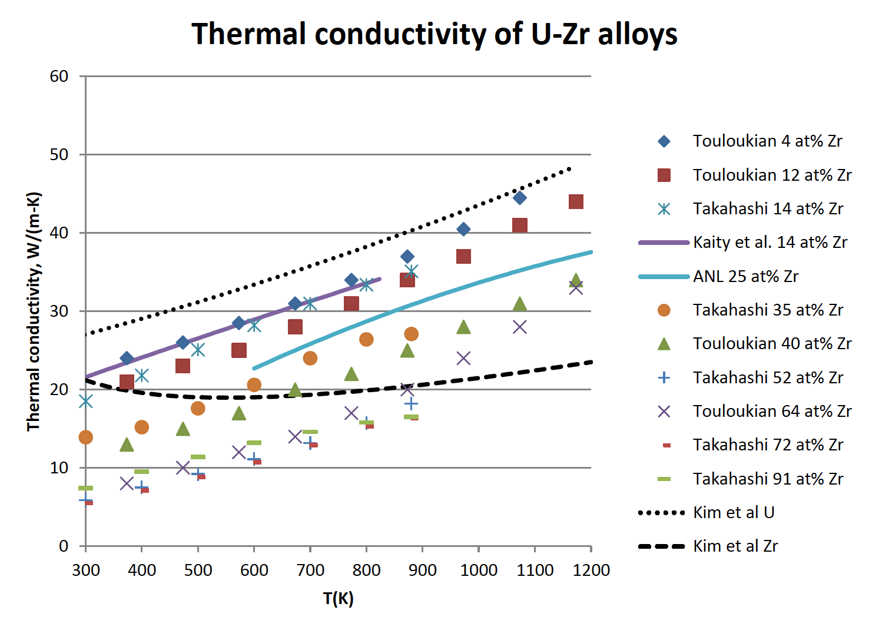
Changes in Thermal Conductivity
U-Zr has a very high thermal conductivity compared to oxide fuels
However, developing porosity will degrade the thermal conductivity
Understanding the temperature also governs how the porosity will develop and how redistribution will vary axially
This is a coupled problem that is complex, but critical for prediction of fuel evolution

Slide 25
Changes in Thermal Conductivity
Bond sodium plays an important role on the thermal behavior of the fuel during irradiation
At the point where the fuel reaches its maximum swelling the porosity in most of the fuel interconnects and gas is vented to the plenum
This allows the bond sodium to infiltrate the fuel body and increase the fuel’s overall thermal conductivity
Sodium infiltration is known because in PIE, the sodium level above the fuel elements, where the fuel has swelled out to the cladding, is always substantially lower than the total amount of preloaded sodium would indicate
Chemical analysis of irradiated fuel finds this “missing” sodium distributed throughout the fuel pin

Slide 26
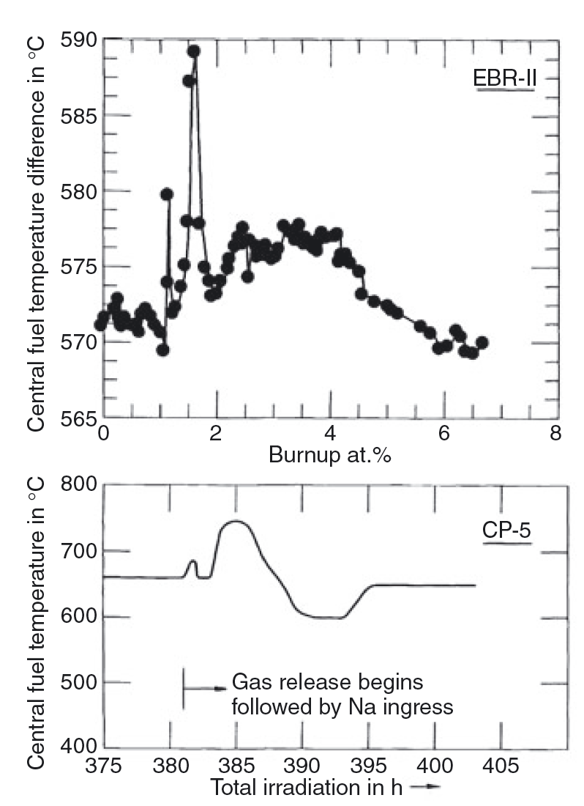
Changes in Thermal Conductivity
On average, approximately 15–20% of the porosity is filled with sodium
The overall thermal conductivity of the fuel drops continuously during the early free-swelling stage, due to porosity development, but then increases rather suddenly with gas release and sodium logging
Experiments at right had thermocouples in the center of the fuel

Slide 27
Fuel-Cladding Interaction
Fuel-Cladding interactions are both mechanical and chemical in nature (FCMI and FCCI)
FCMI results from when the fuel swells, comes into contact with the cladding, and exerts an outward force on the cladding
Early element designs did not allow the fuel sufficient free swelling, this gas bubble pressure was transmitted directly to the cladding
Thus, all early designs suffered from cladding deformation and rupture at modest burnups
This was one of the primary reasons oxide fuels were pursued over metallic alloys
By the time the smear density solution had been implemented, metallic fuels had already been left behind

Slide 28
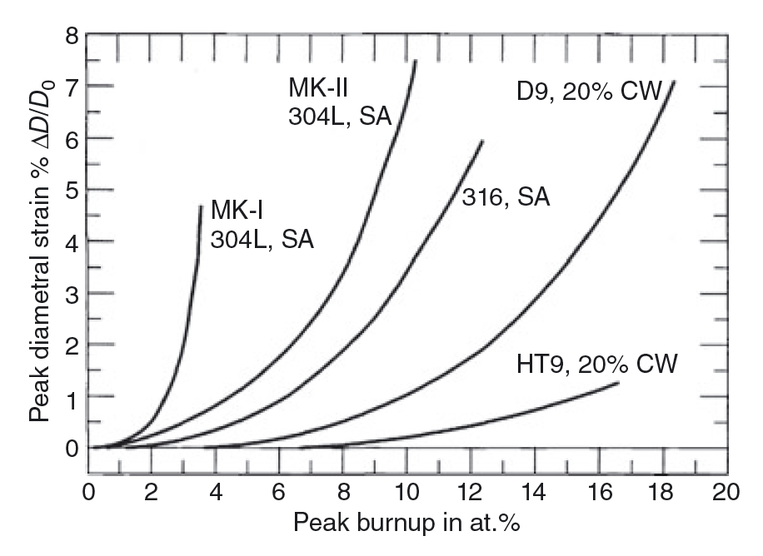
Fuel-Cladding Mechanical Interaction
The cladding strain of high smear density, small plenum fuel rod designs is primarily creep strain due to FCMI (MK-I)
The cladding strain of low smear density, large plenum rods is mainly irradiation-induced cladding swelling (MK-II)
The creep strain can be accounted for by the plenum pressure stress alone, which confirms that FCMI is virtually nonexistent in suitably designed metallic fuel elements
Significant FCMI can be avoided to high burnup if the as-built fuel smeared density is kept to 75%, and a sufficient gas plenum is employed

